Slide 1
2 Data Visualization
by Xu Shen

Slide 2
Agenda
Homework Review
Concept of Data Visualization
Purpose of Data Visualization
Elements of Data Visualization
Weapons You Can Use
Tools and Libraries
Some Toy Problems
Data Visualization on Benz Example

Slide 3
Homework Review
Try creating a 5*10 data frame
Think of 3 real world examples in each of four problem types
Think of an example when interpretability is more important than prediction accuracy
Try to use a new package in sklearn to classify the iris dataset

Slide 4
Data Visualization
Human are visual animals, 90% of the information are perceived by our eyes.
Help us to understand the data and problem in a more informative way.
The first step to solve any problem is to observe.

Slide 5
Before Data Visualization…
Text to numeric
Scale
Missing Value
Duplicates
Matrix for specific models

Slide 6
Purpose of Data Visualization
Summary Statistics
Outlier detection
Relationship between different variables
Heatmap
See the trend

Slide 7
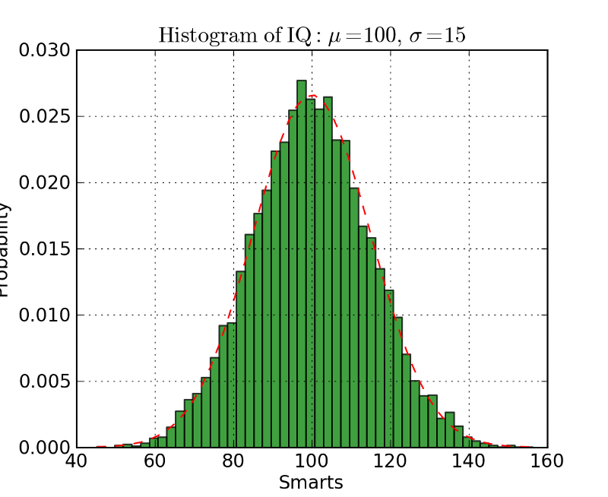
Summary Statistics

Slide 8
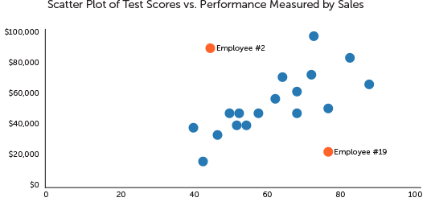
Outlier Detection

Slide 9
Outlier Detection

Slide 10
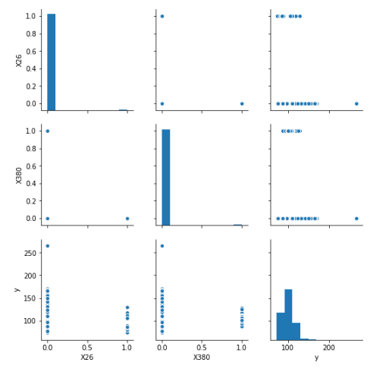
Relationship Between Variables

Slide 11
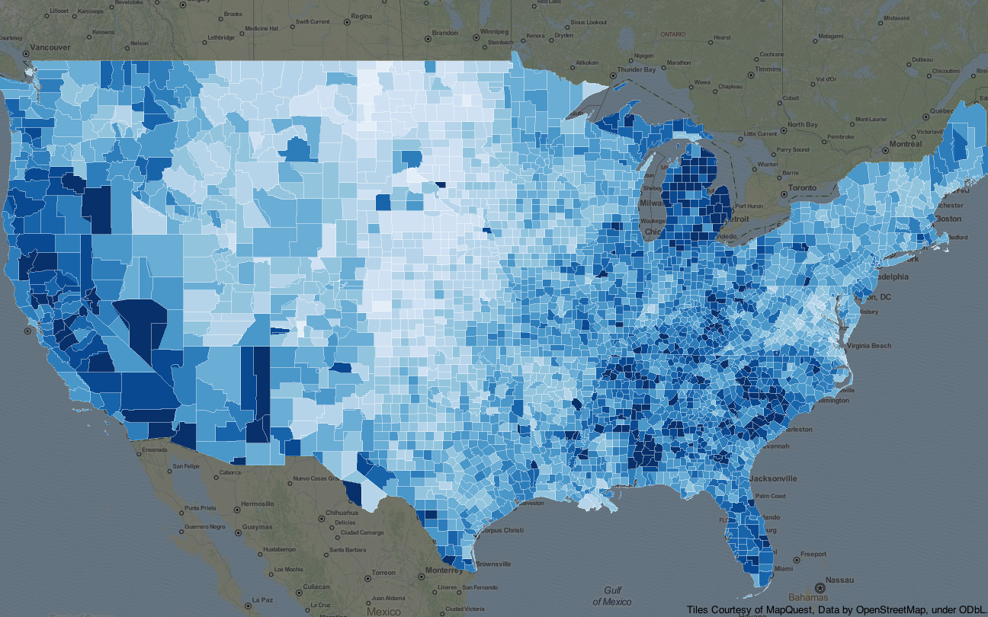
Distribution in a wide range

Slide 12
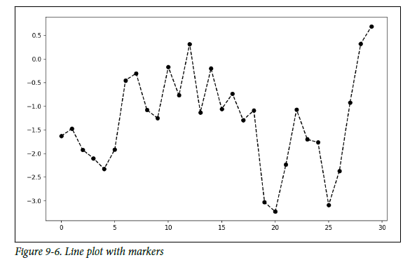
See the trend

Slide 13
Elements of Data Visualization
Color
Points
Type
Legend
Title
X-axis and Y-axis(Sometimes Z-axis)

Slide 14
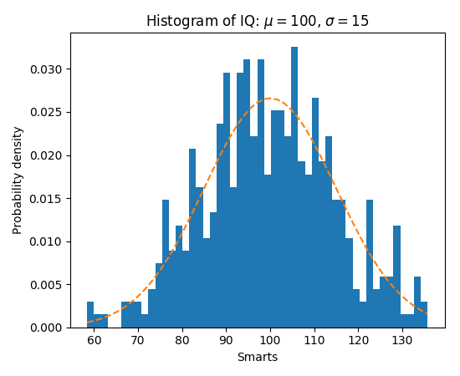
Weapons-Histogram

Slide 15
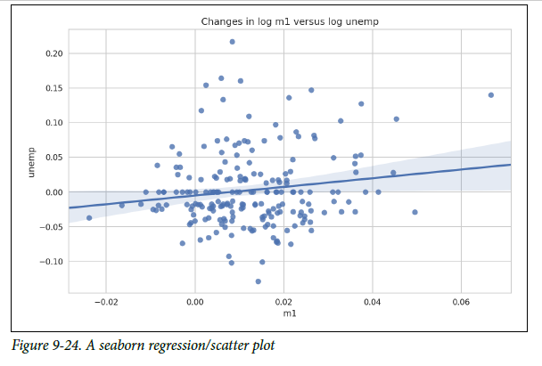
Weapons-Scatterplot

Slide 16
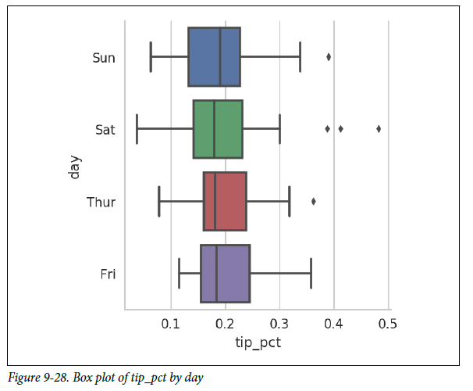
Weapons-Box Plot

Slide 17
Visualization Tools
Matplotlib
Seaborn
R and ggplot2
Tableau
Excel

Slide 18
Toy Problem
Try to create a scatter plot between two variables you are interested
Try to find the distribution of a variable that doesn’t follow normal distribution

Slide 19
Use Data Visualization to Observe Benz Dataset
Run through all the code in lab1

Slide 20
Homework
Write your own Data Visualization program based on Benz dataset and lecture notebook.
Add description for what you are visualizing and how does this image could help predict your target variable in the challenge.

